Slide 1
Pathfinder
Select an egress model to meet the needs of the project
Use Pathfinder to predict egress times

Slide 2
Historic Fire
Brown’s Ferry

Slide 3
Pathfinder
http://www.thunderheadeng.com/pathfinder/download/
6348 2163 AFE4 2196 5979 19
Read: http://www.nist.gov/customcf/get_pdf.cfm?pub_id=906951

Slide 4
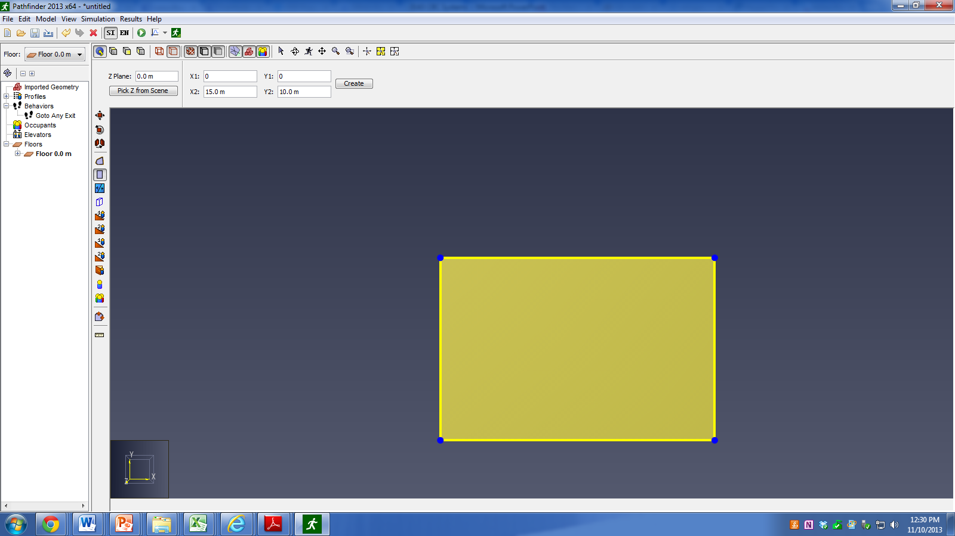
Pathfinder
Draw Room

Slide 5
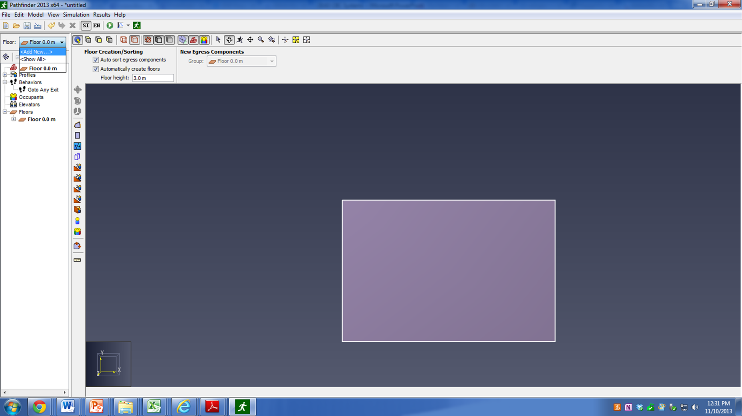
Pathfinder
Add new floors

Slide 6
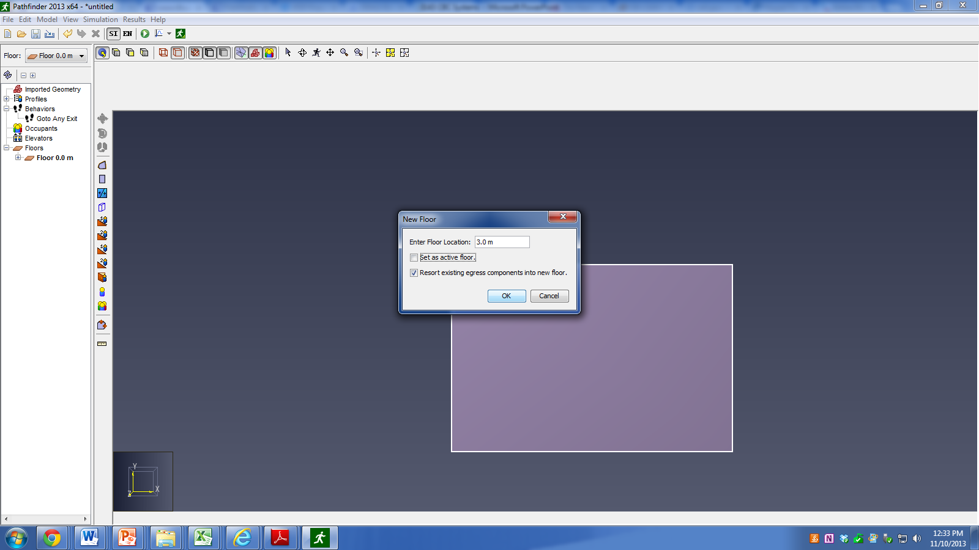
Pathfinder
3 m between floors

Slide 7
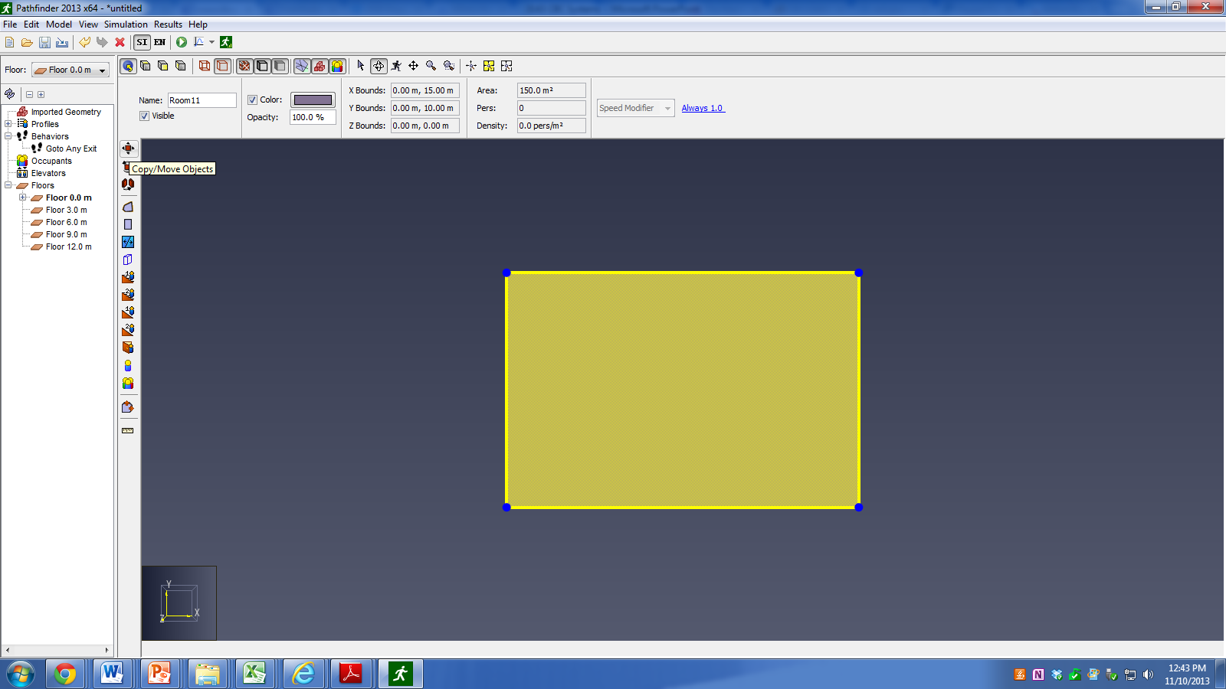
Pathfinder
Copy room to other floors

Slide 8

Pathfinder
Four new rooms needed

Slide 9
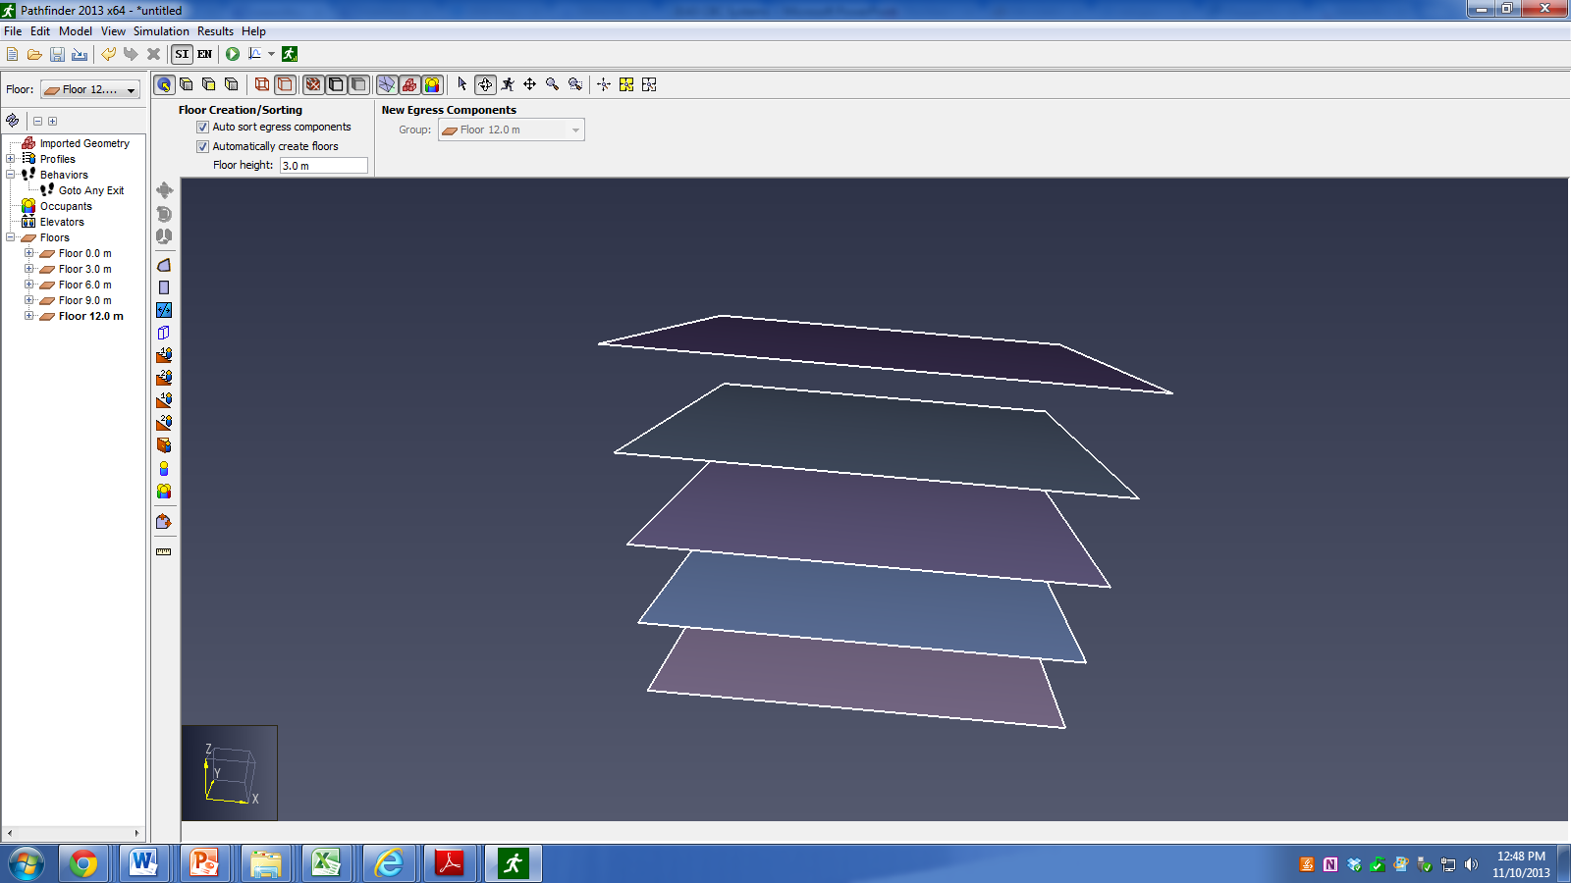
Pathfinder
Rotate view to see all floors

Slide 10
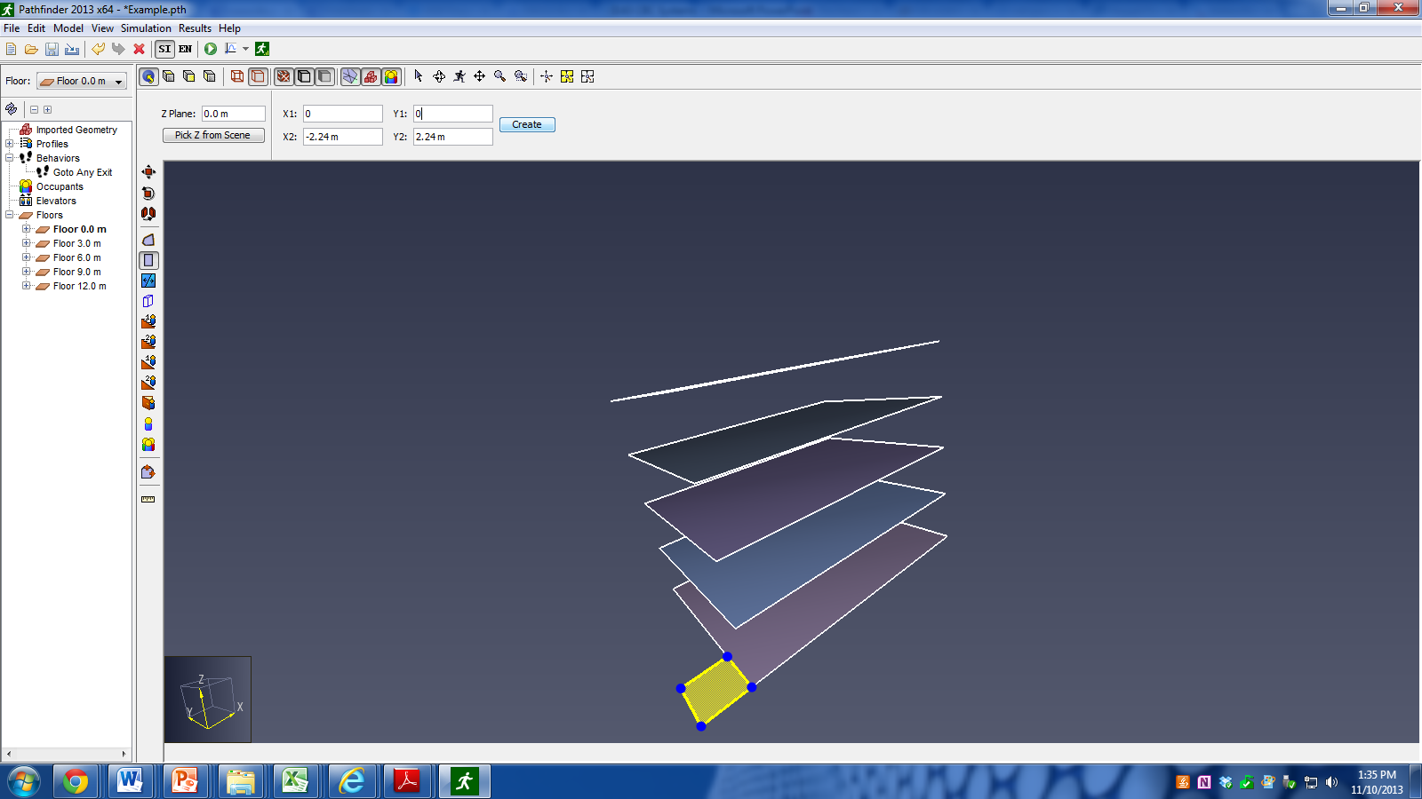
Pathfinder
Add room for stairs

Slide 11
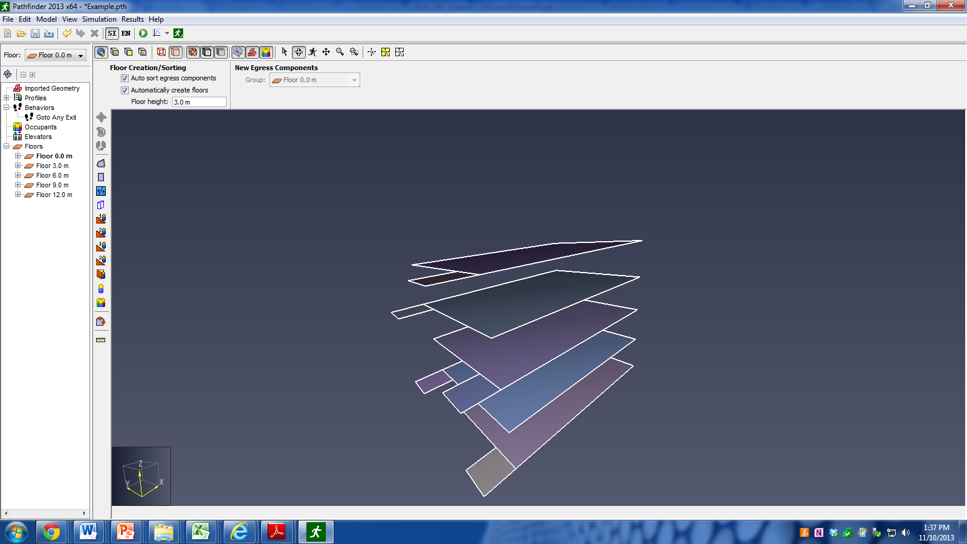
Pathfinder
Copy and move to other levels

Slide 12
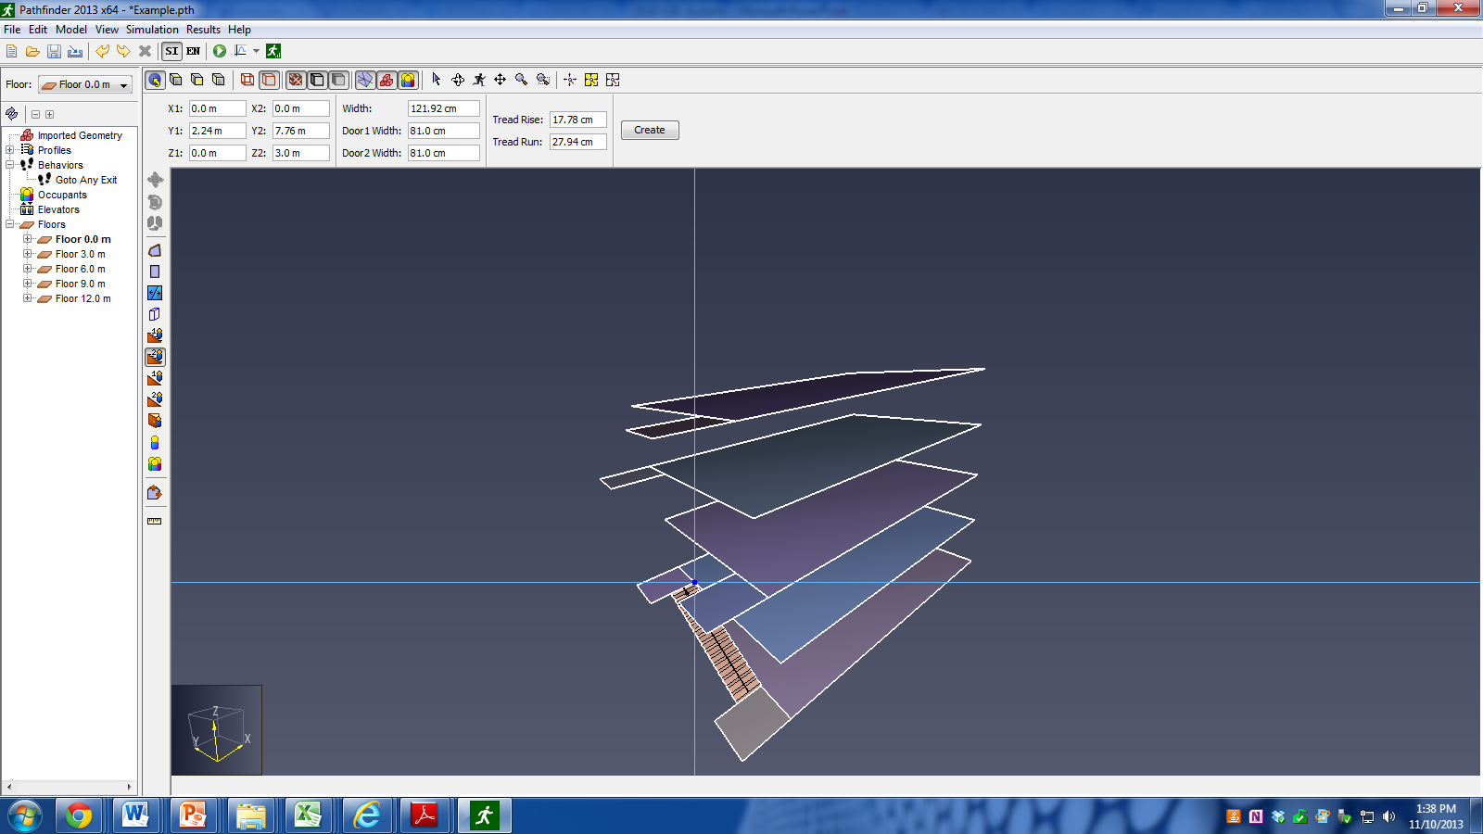
Pathfinder
Add stairs

Slide 13
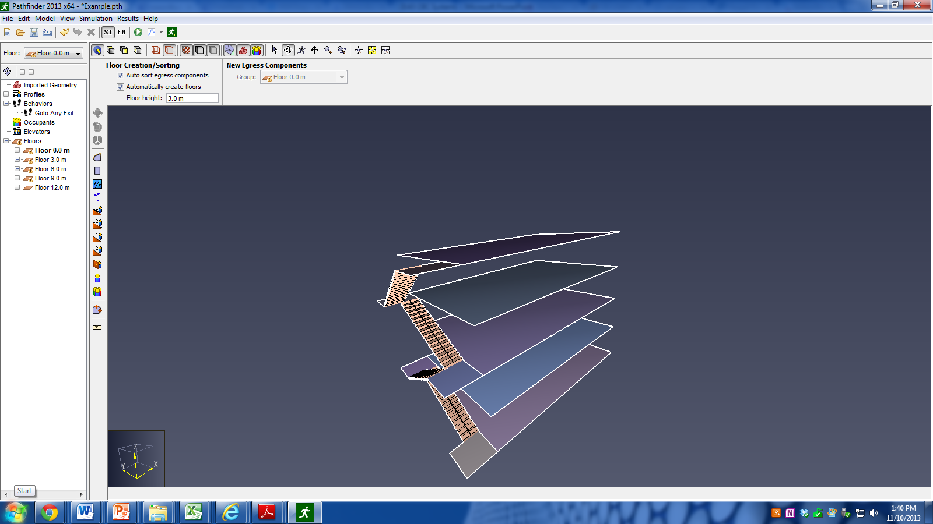
Pathfinder
Stairs connecting all floors

Slide 14

Pathfinder
Add exit door

Slide 15
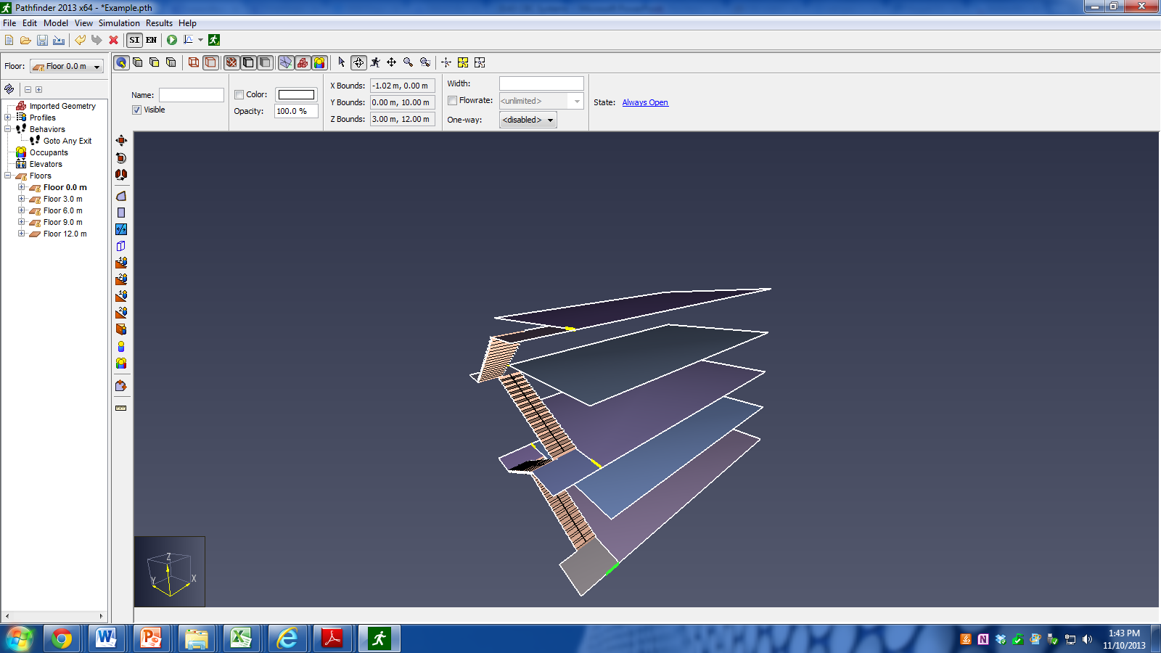
Pathfinder
Stair doors on other floors

Slide 16
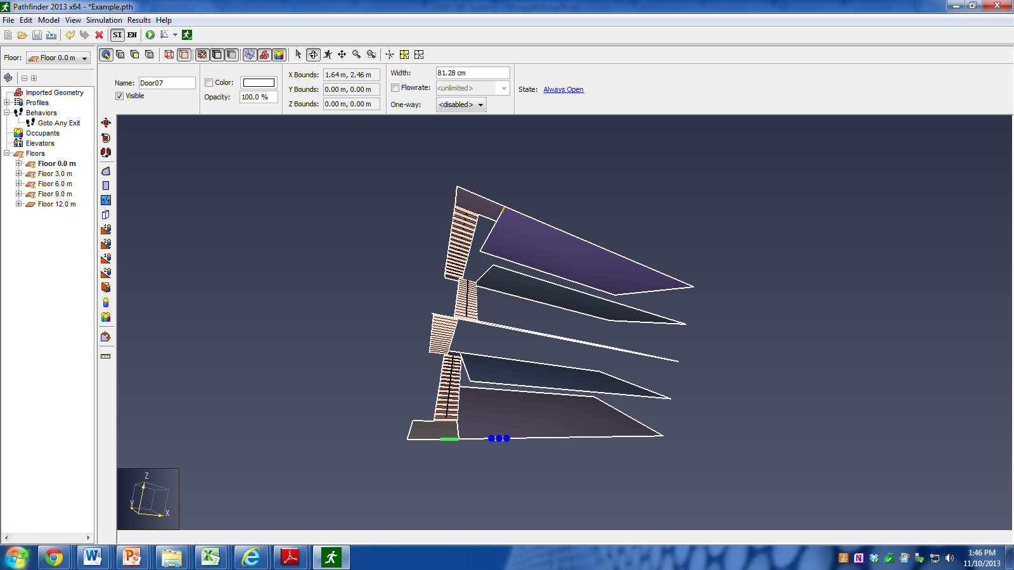
Pathfinder
Add exterior door

Slide 17
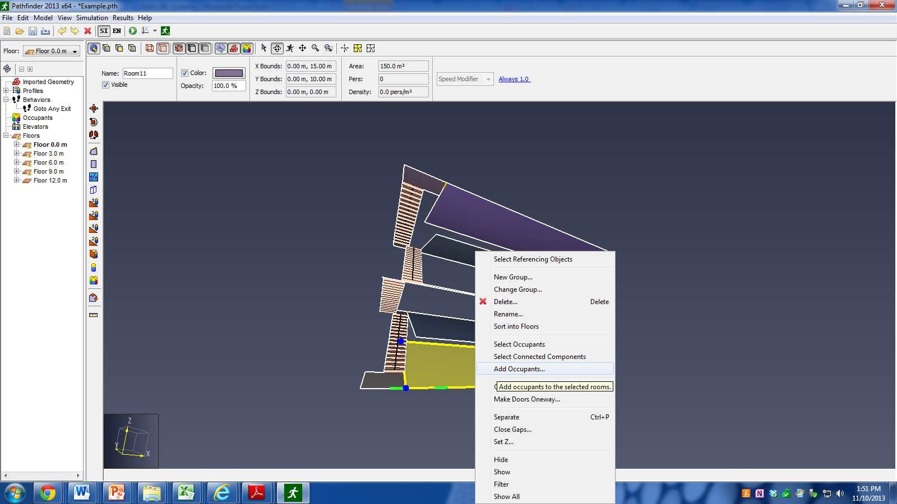
Pathfinder
Add occupants

Slide 18
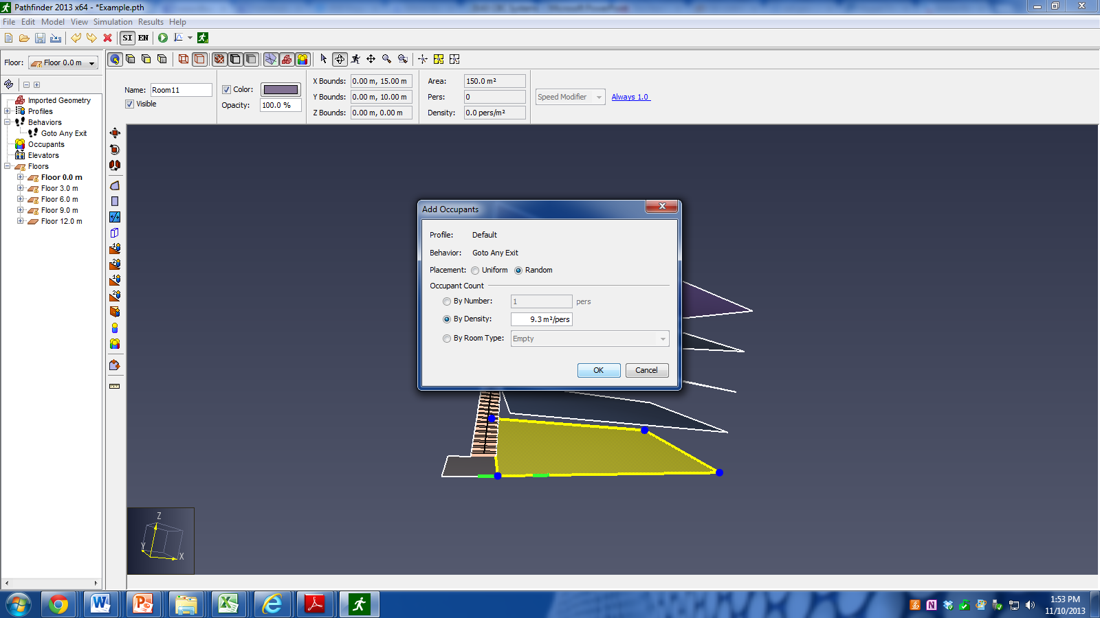
Pathfinder
Business

Slide 19
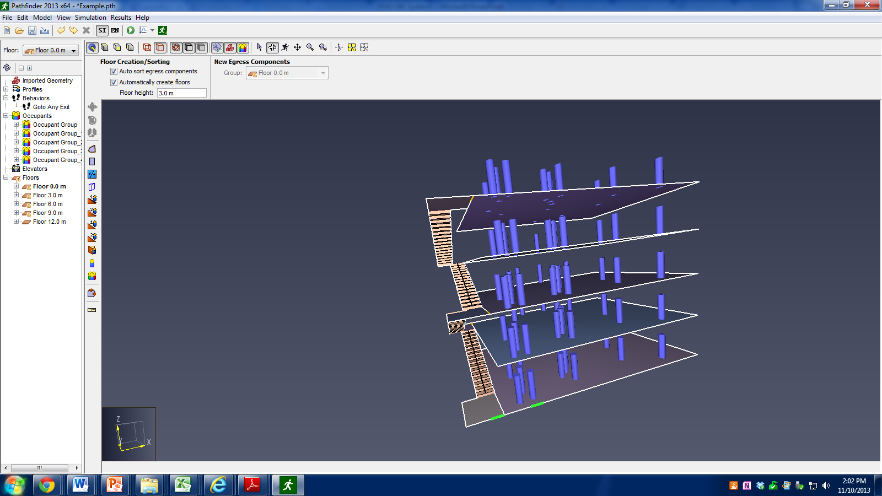
Pathfinder
Put occupants on all floors

Slide 20

Pathfinder
Run simulation

Slide 21
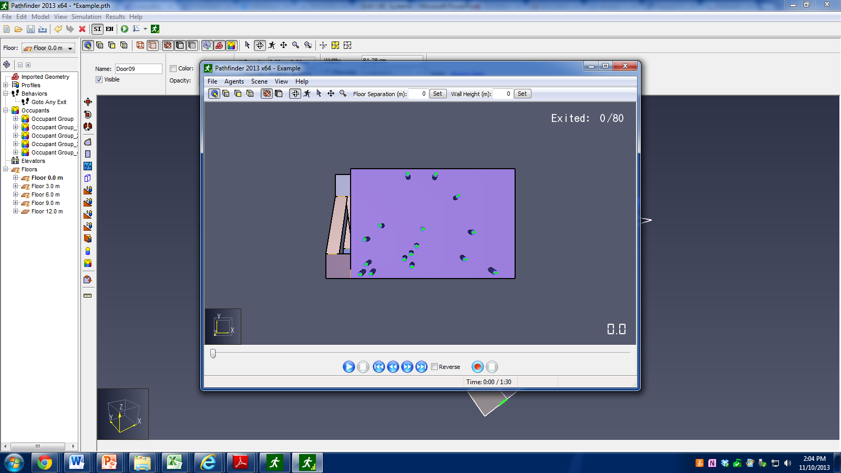
Pathfinder
After following prompts, simulation runs and movie pops up
Can rotate view

Slide 22
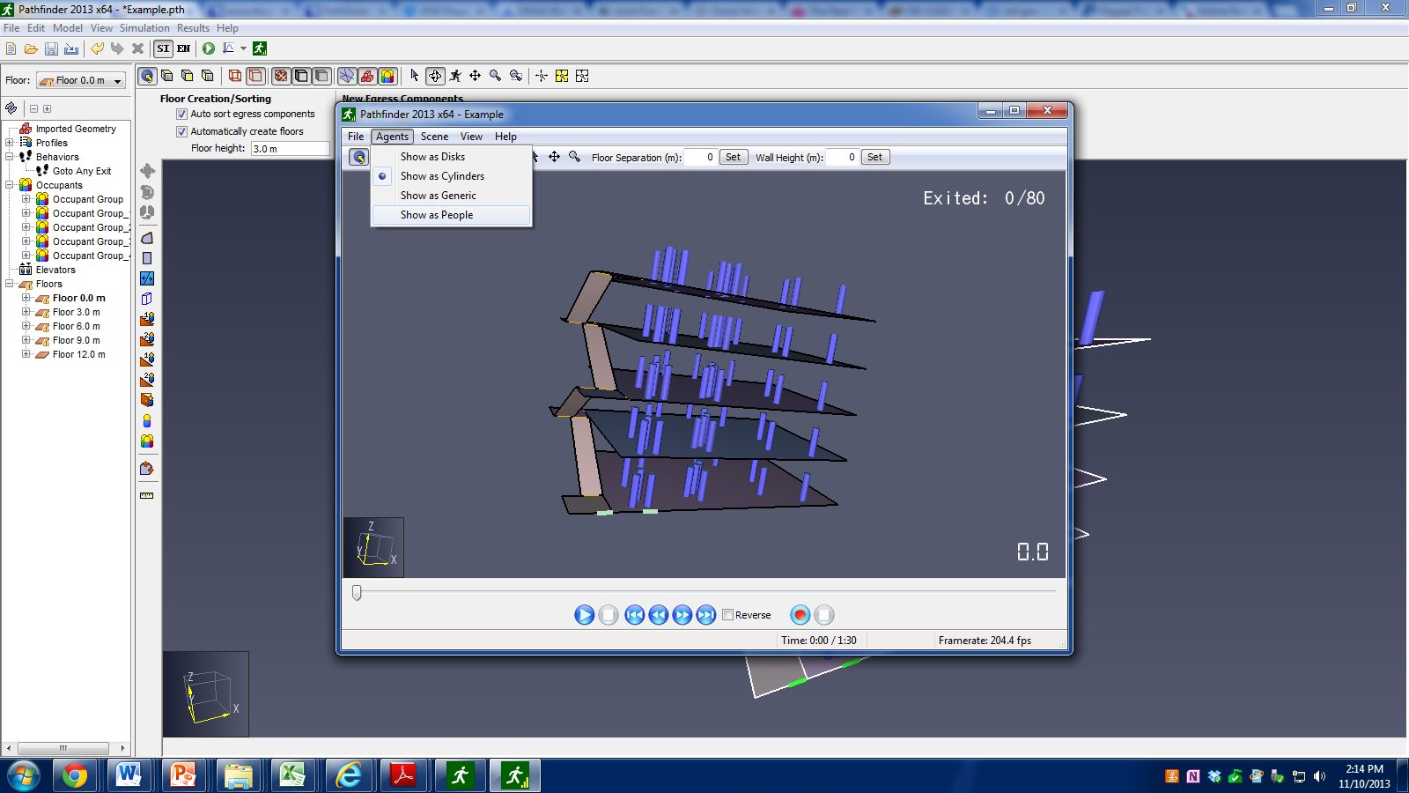
Pathfinder
Can manipulate image

Slide 23
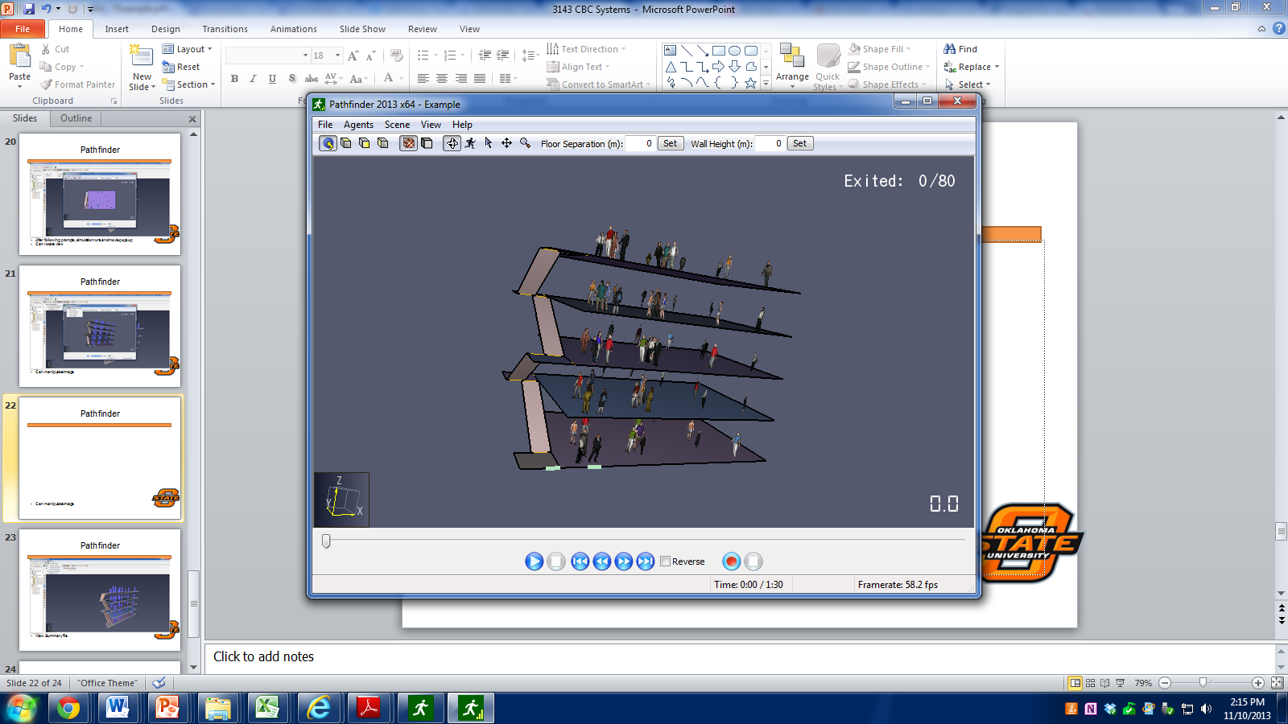
Pathfinder
Can manipulate image

Slide 24
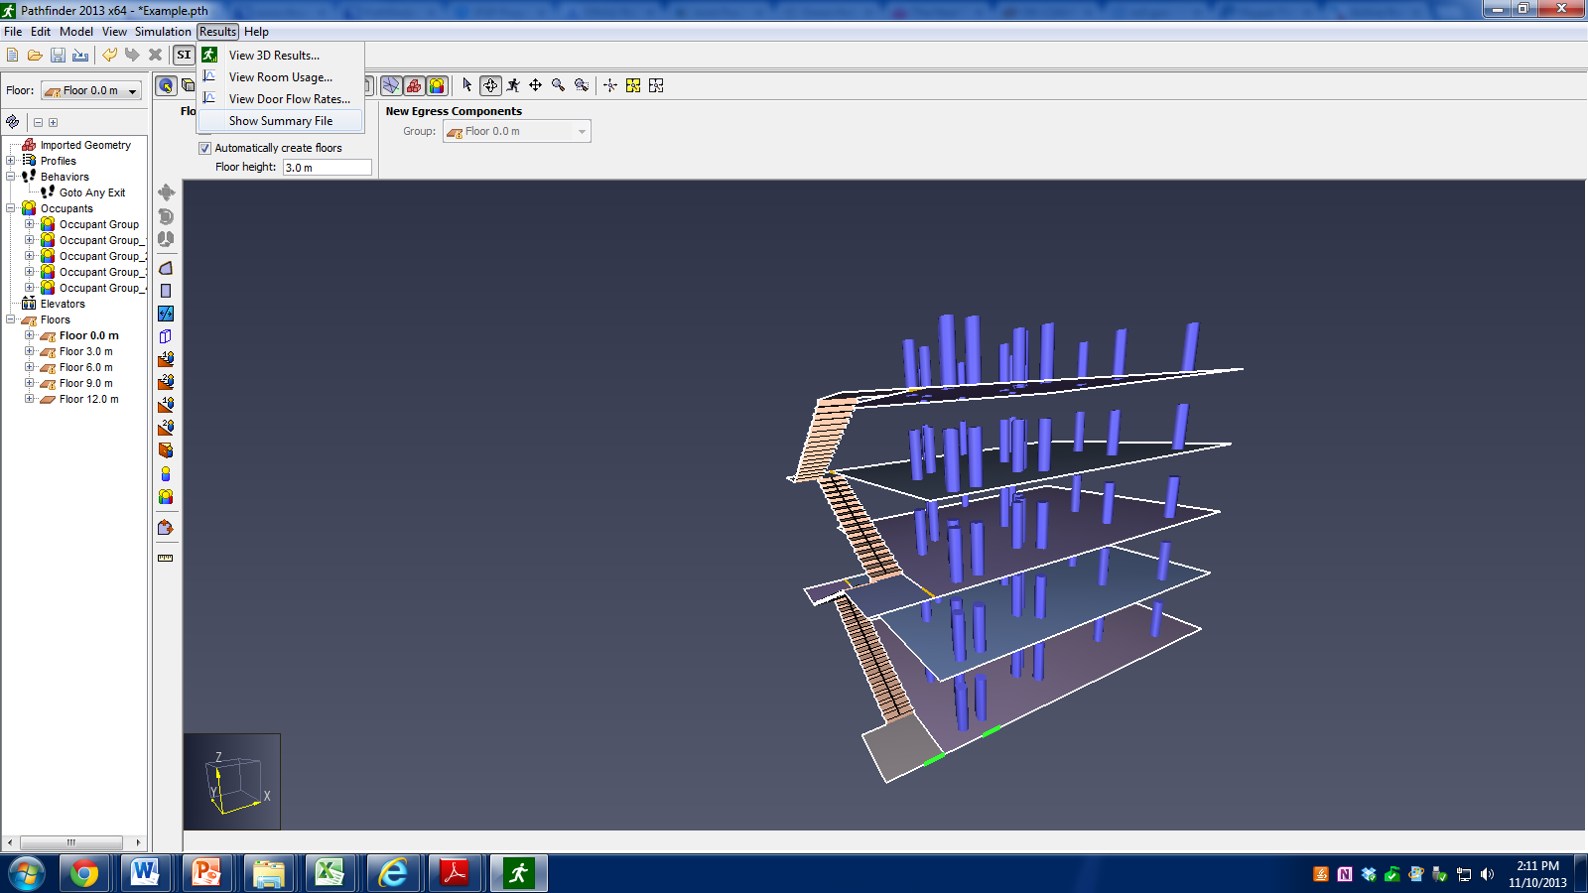
Pathfinder
View Summary file

Slide 25
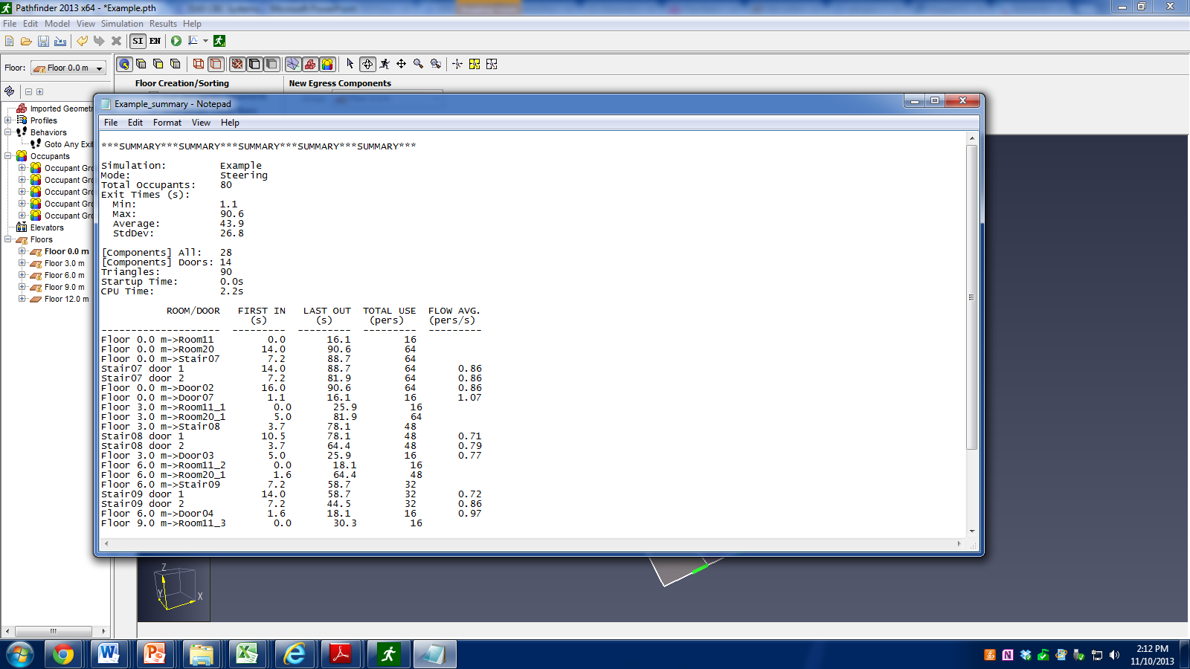
Pathfinder
Summary File

Slide 26
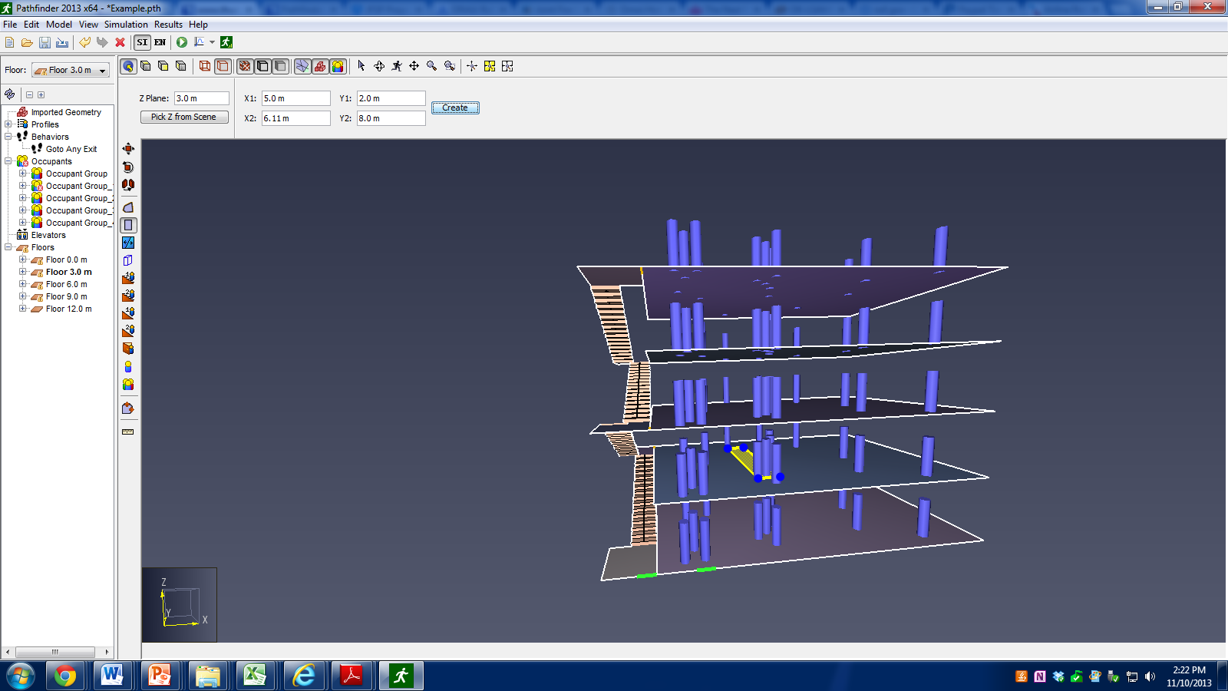
Pathfinder
Create hole by adding new room inside old room
Copy to floor above
Delete new rooms

Slide 27

Pathfinder
Add stair

Slide 28
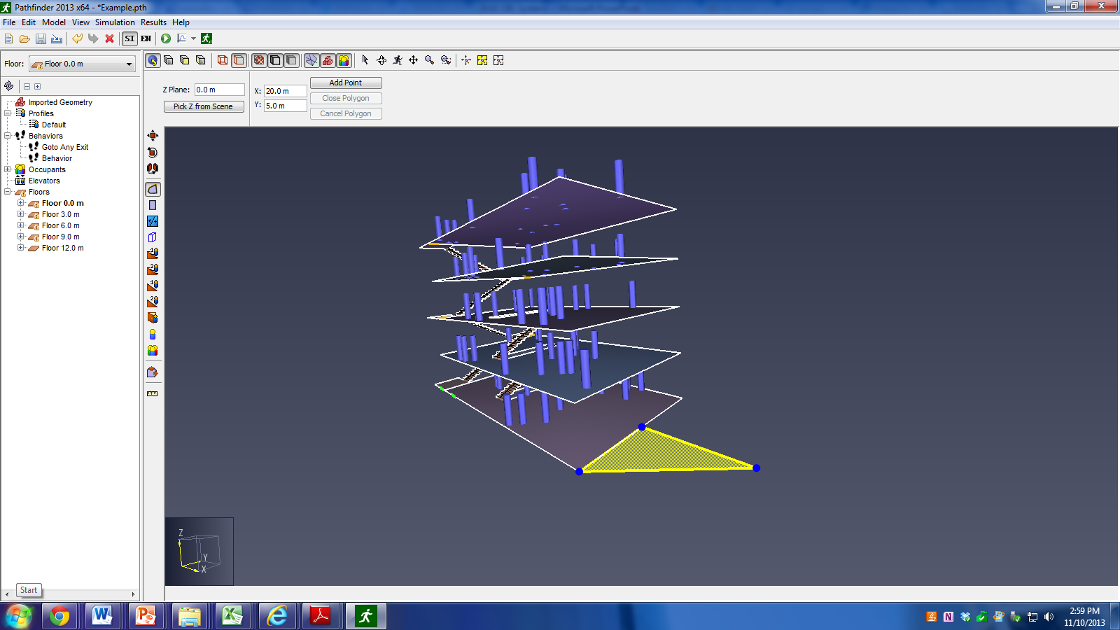
Pathfinder
Create triangular room
5 m base and height

Slide 29
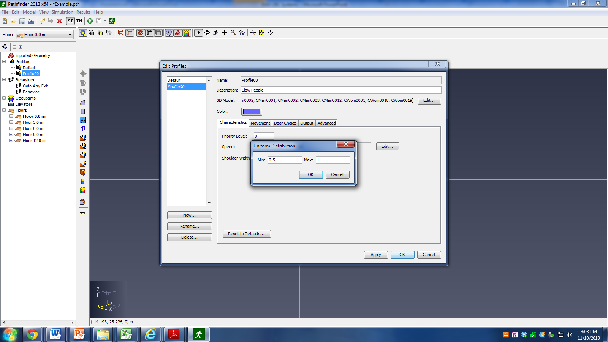
Pathfinder
Add in three occupants
Make one slow moving
Apply to selected occupants on each floor

Slide 30
Pathfinder
Modifying occupants
Double click on profiles
Individual occupants
Select one occupant
Exit choice and pre-evacuation time
Double click on behaviors

